Slide 1
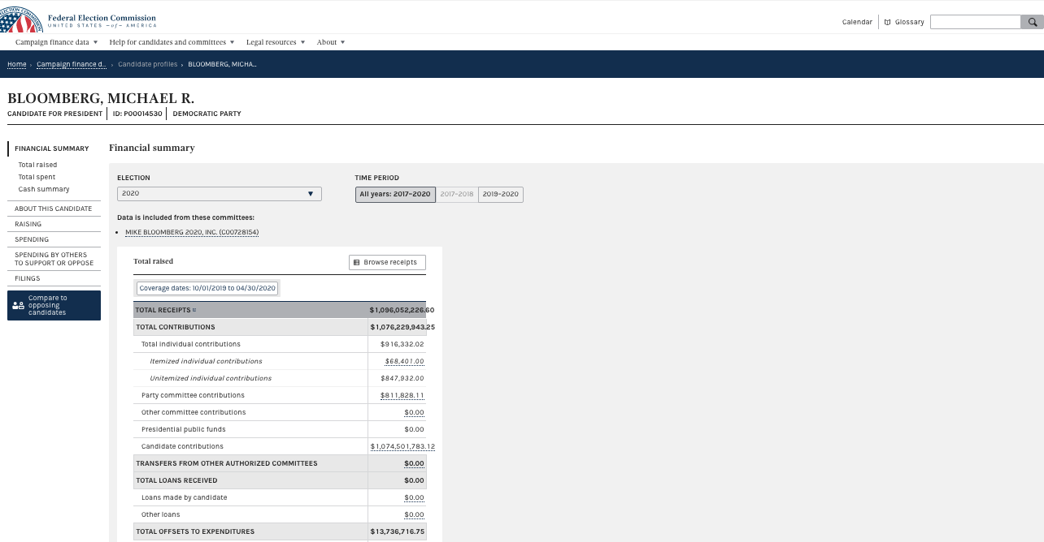
Covering the Federal Government with Data
Randy Leonard
Digital frameworks
Northwestern University – Spring 2020
Github.com/randyleonard99/digitalframeworks-spring2020

Slide 2
Steps to a data story
Find data
Clean data
Analyze data
Present data

Slide 3
Agenda
FEC data
Lobbying data
Financial disclosure data

Slide 4
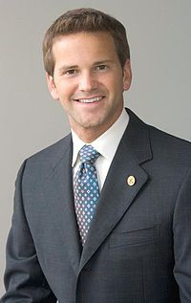
Crooks and Campaign Finance
Recognize this guy?

Slide 5

Crooks and Campaign Finance
Does this help?

Slide 6
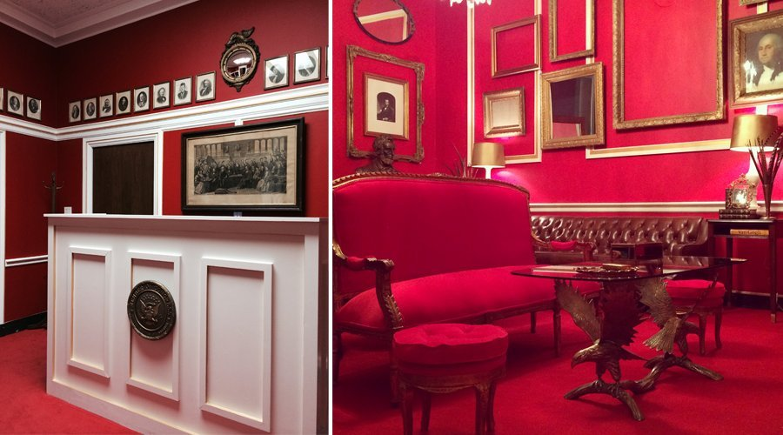
Crooks and Campaign Finance
He liked Downton Abbey … a lot.

Slide 7
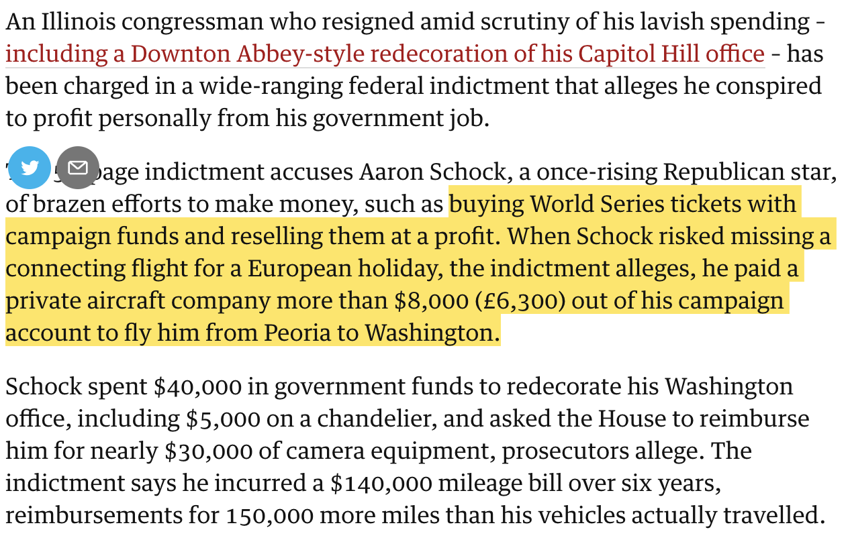
Crooks and Campaign Finance
Notes:
This was at the end of 2016 … Trial set for next January

Slide 8
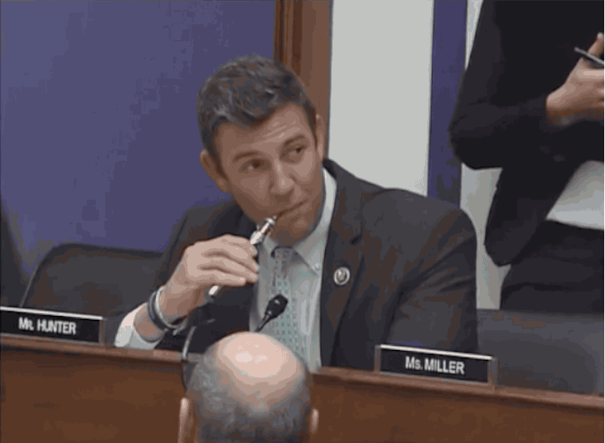
Crooks and Campaign Finance
Notes:
This was at the end of 2016 … Trial set for next January

Slide 9
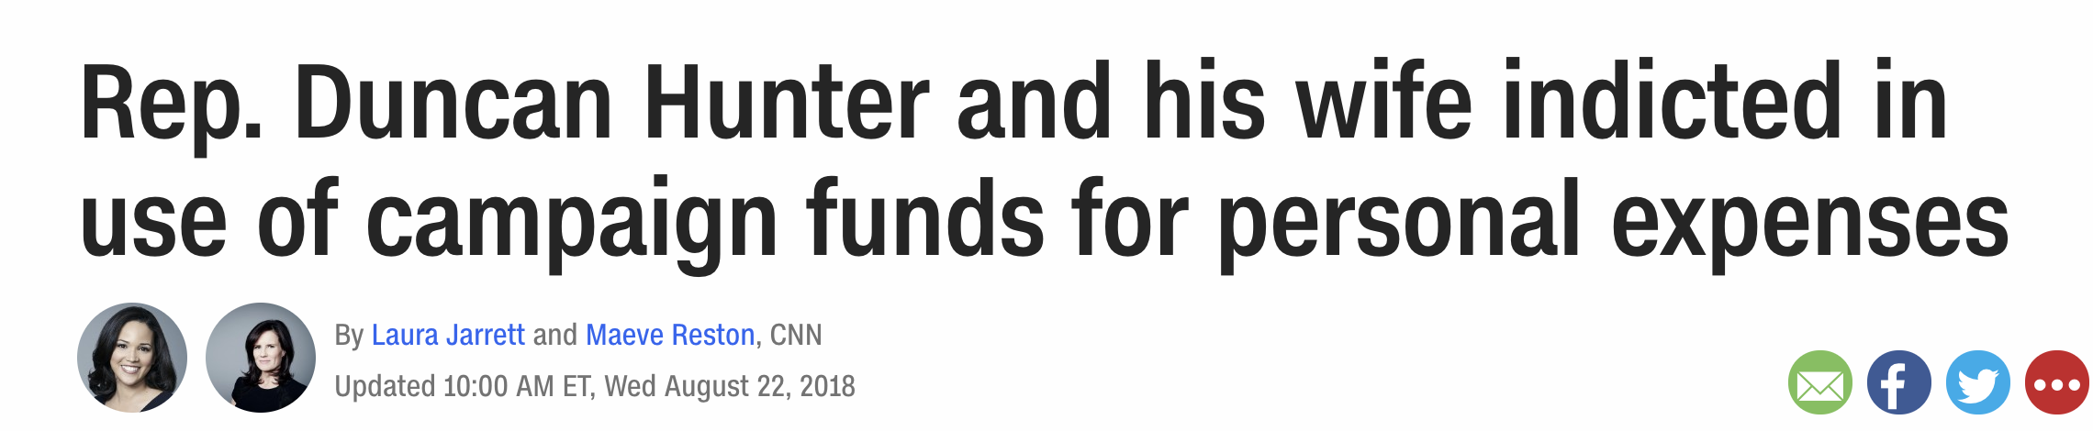
Crooks and Campaign Finance
Notes:
This was at the end of 2016 … Trial set for next January

Slide 10
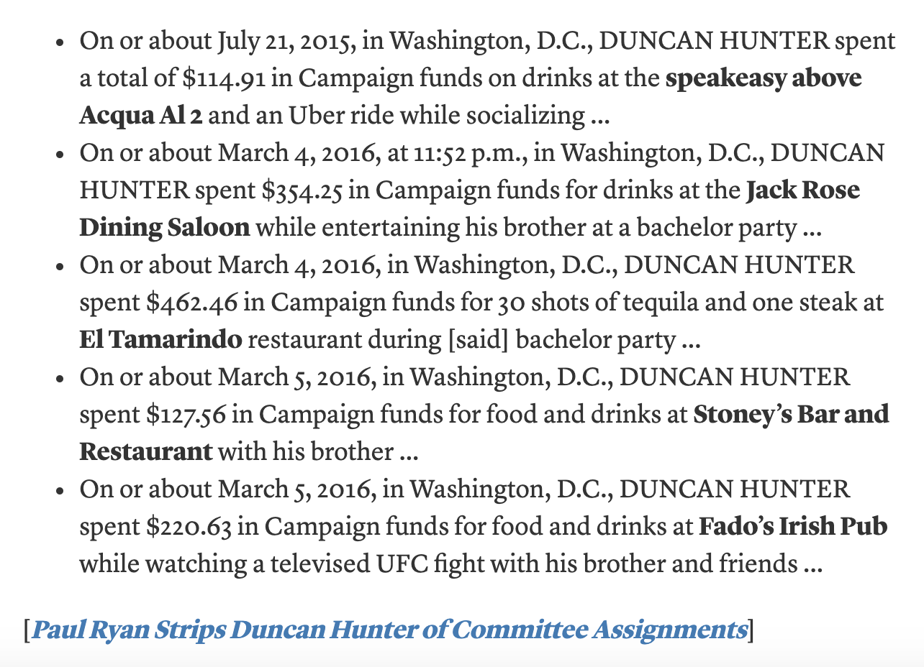
Crooks and Campaign Finance
Notes:
This was at the end of 2016 … Trial set for next January

Slide 11
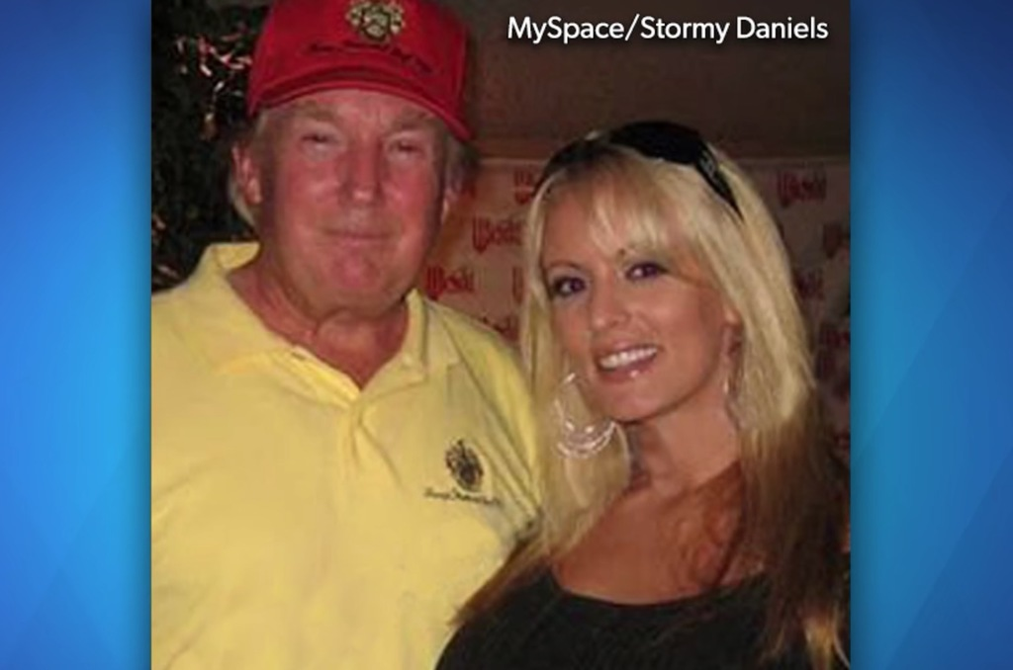
Crooks and Campaign Finance
Recognize this pair?

Slide 12
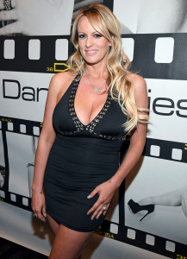


Crooks and Campaign Finance

Slide 13
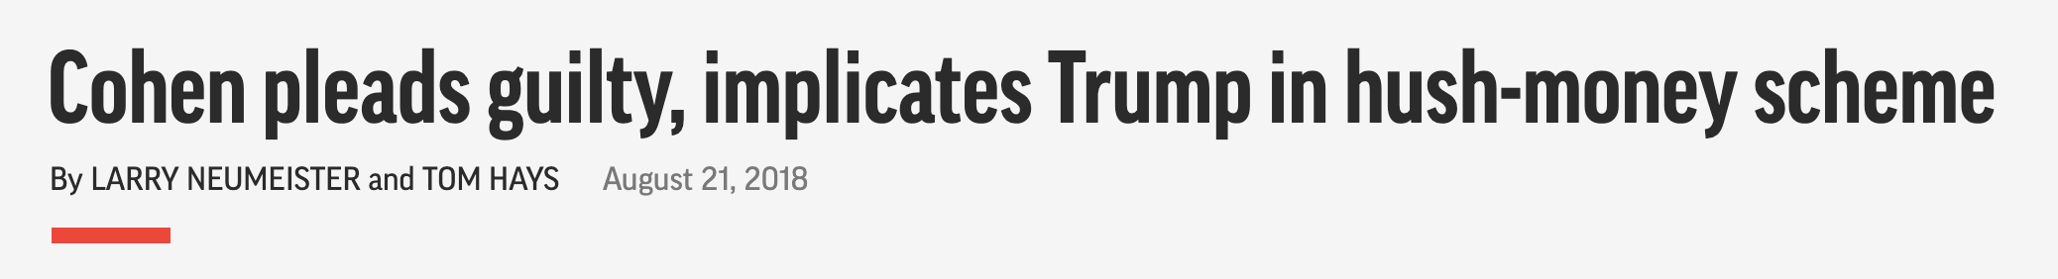
Crooks and Campaign Finance

Slide 14
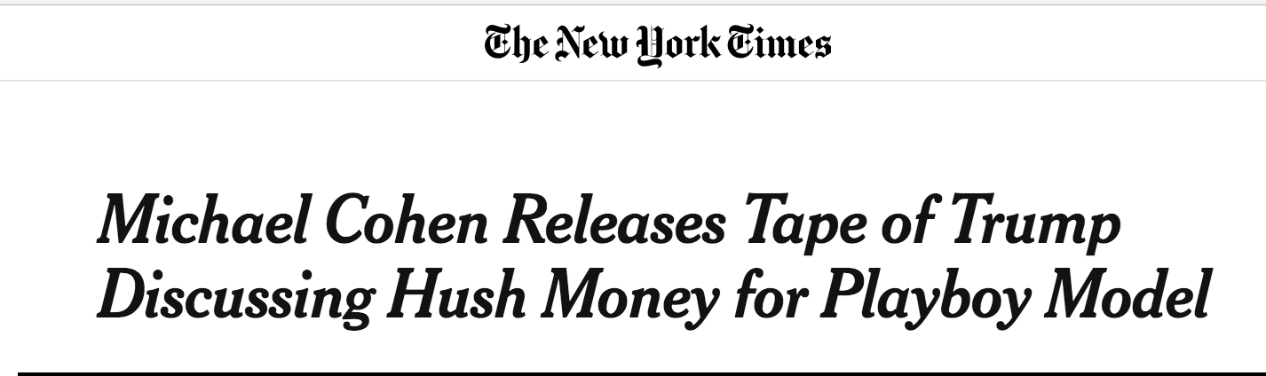
Crooks and Campaign Finance

Slide 15
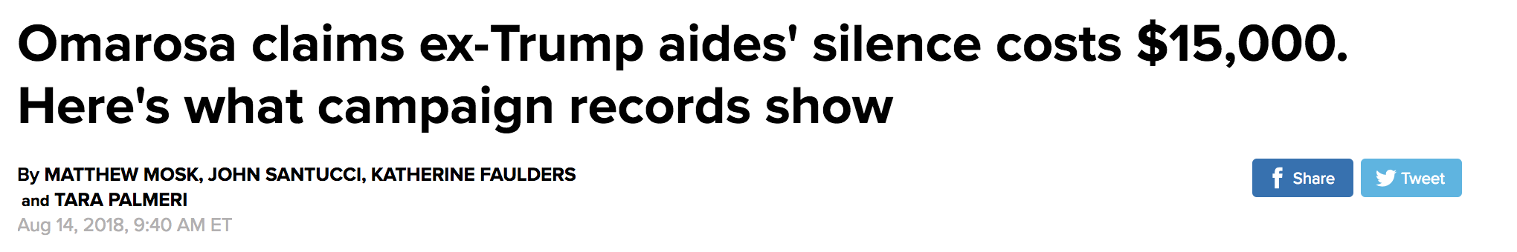
Crooks and Campaign Finance

Slide 16
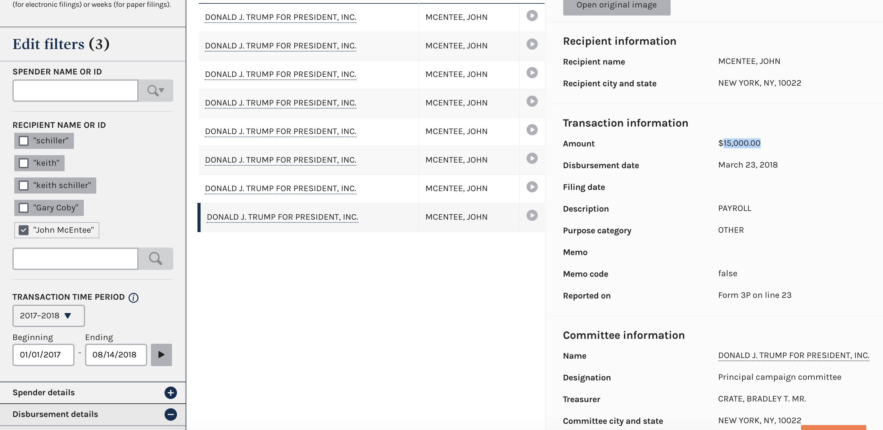
Crooks and Campaign Finance

Slide 17
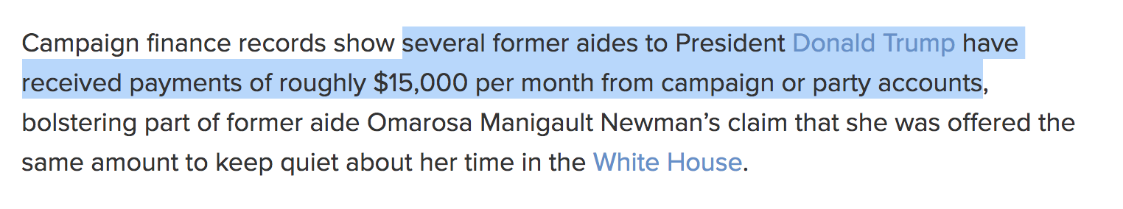
Crooks and Campaign Finance

Slide 18
Campaign Finance
All campaign contributions over $200 per cycle must be itemized and reported by the committee that receives them
All campaign expenditures must be itemized and reported by the committee

Slide 19
Campaign Finance
Rachel Shorey: Three general types of camp fin stories:
Horserace stories: Which candidate is winning the money race?
Donor stories: Who is giving money (and why)?
Legal analysis stories: How are candidates working creatively inside (or outside) the law?

Slide 20
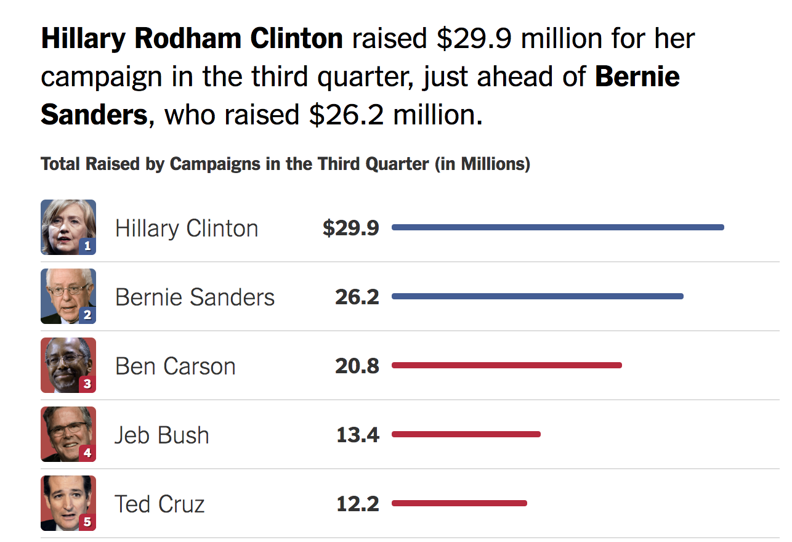
Campaign Finance

Slide 21
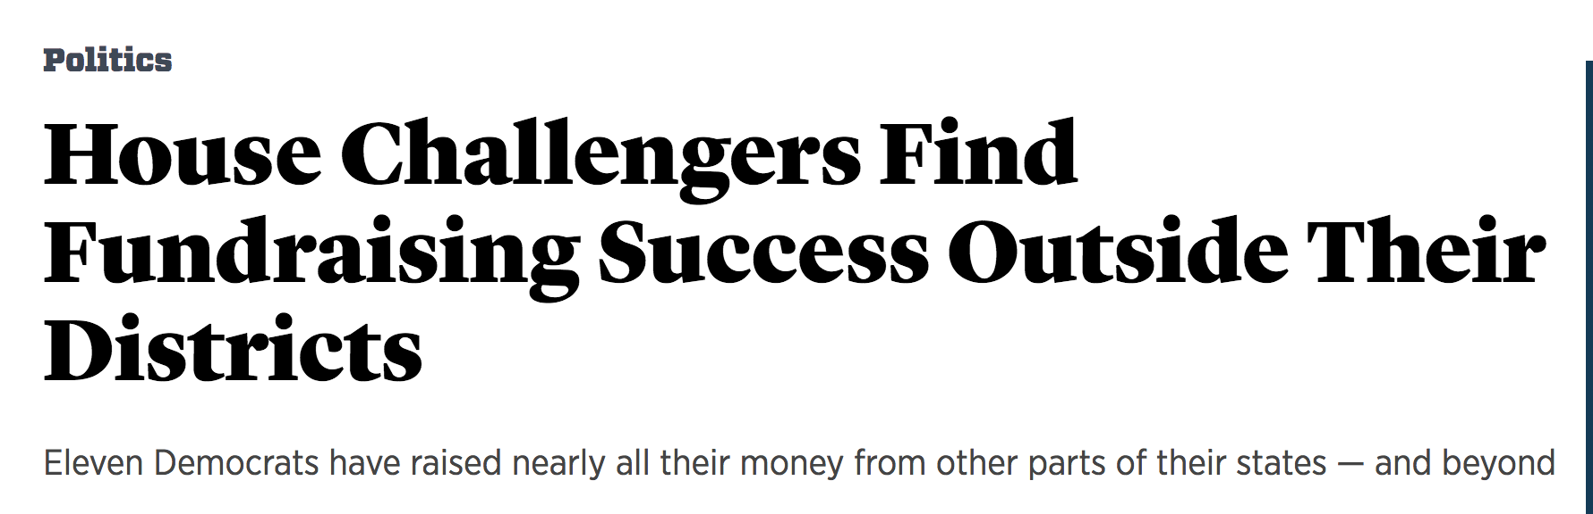
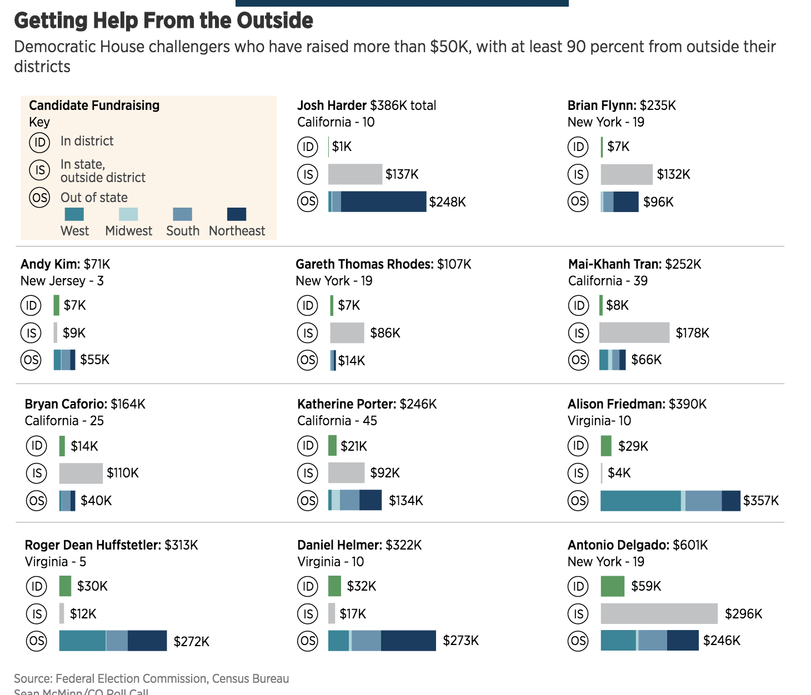
Campaign Finance

Slide 22
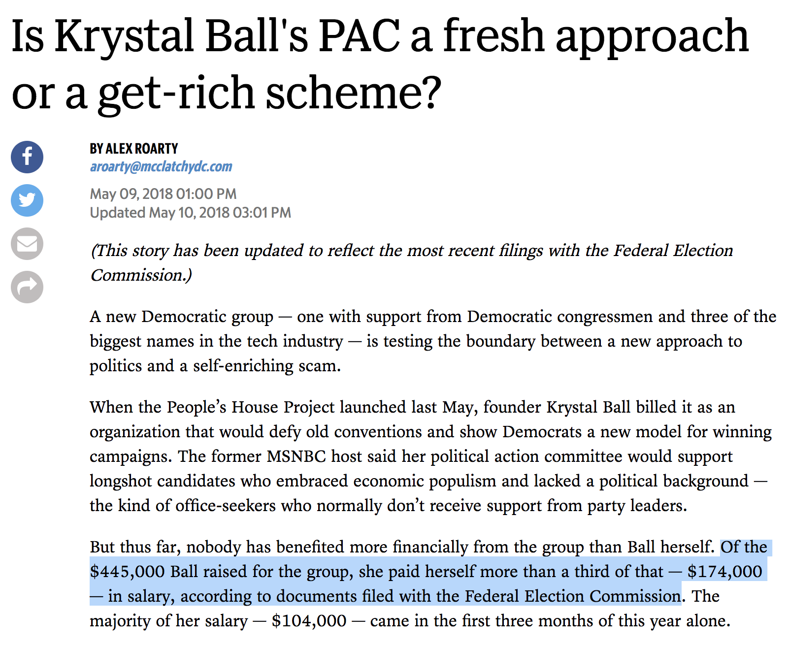
Campaign Finance

Slide 23
Campaign Finance
To touch on PACs:
Anyone can set up their own committee to help a campaign
BUT there’s limitations on how much you can spend
The answer? Super PACs
http://www.cc.com/video-clips/yzb7q2/the-colbert-report-colbert-super-pac---trevor-potter

Slide 24
Campaign Finance
How can reporters find these stories?
FEC.gov – your best friend for federal campaign finance
Notes:
Look up: Spielberg, Northwestern president, Trump Northwestern donations, Clinton Northwestern donations

Slide 25
Campaign Finance
Pitfalls
Amendments
Refunds
$200 caveat – small vs big donors (per cycle)
***Generally good to check your analysis by someone who’s done this before***

Slide 26
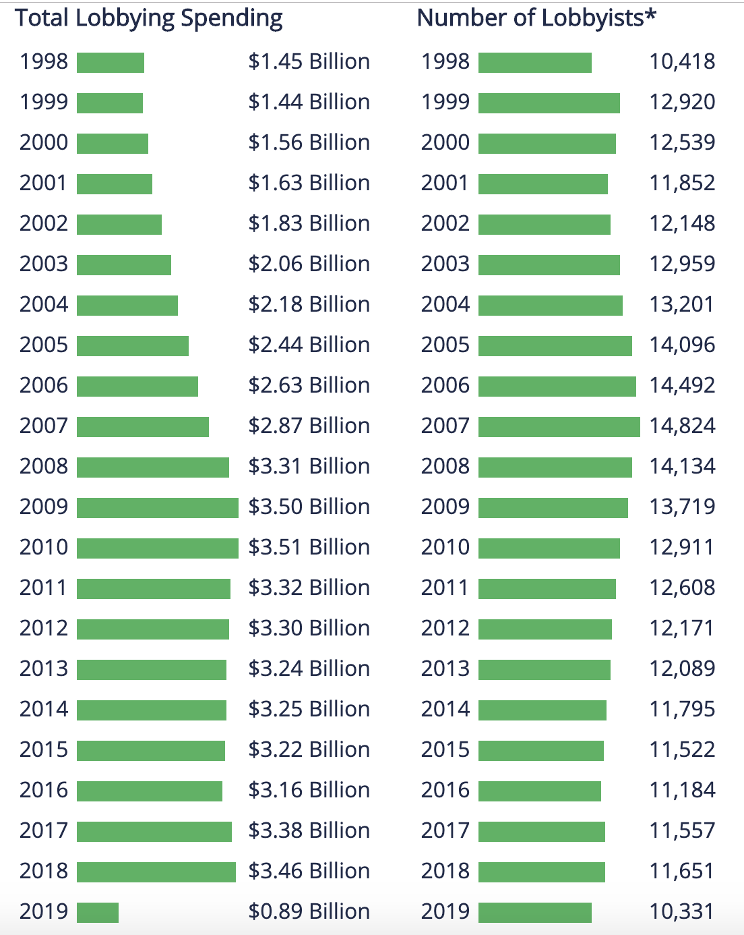
Lobbying
There’s a LOT of money to be made in Washington lobbying
Source: OpenSecrets

Slide 27
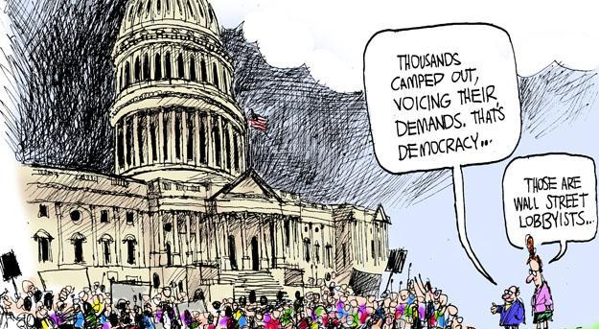
Lobbying

Slide 28
Lobbying
Lobbyists also have to report their spending
But it’s nowhere near as regulated as the FEC’s reports (and that’s saying something)
Only have to register if (via NYT):
Do you make more than $3,000 over three months from lobbying?
Have you had more than one lobbying contact?
Have you spent more than 20 percent of your time lobbying for a single client over three months?

Slide 29
Lobbying
Senate portal for lobbying forms:
https://www.senate.gov/pagelayout/legislative/g_three_sections_with_teasers/lobbyingdisc.htm
Notes:
Check Northwestern University, Facebook

Slide 30
Lobbying
Pitfalls
Aggregate data only avail in XML
Clients and lobbyists both have to report same spending on different reports
Numbers are approximate
Lobbying topics are not exclusive to one report
Amendments

Slide 31
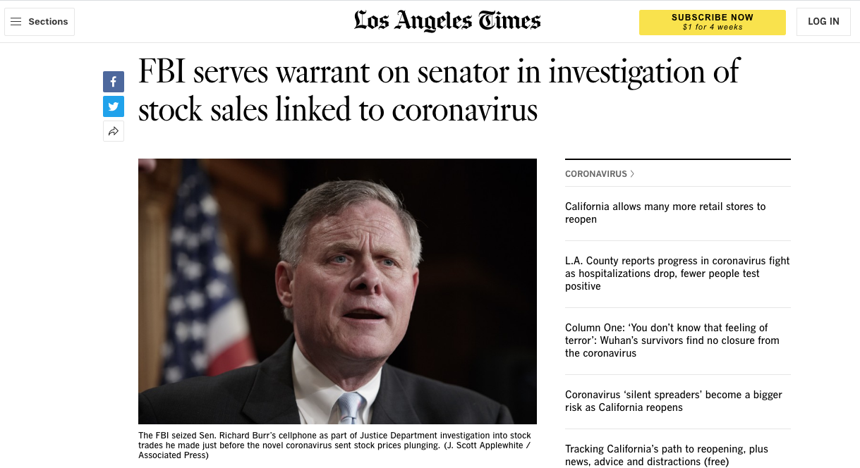
Financial disclosures

Slide 32
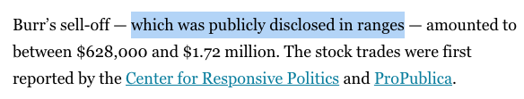
Financial disclosures

Slide 33
Financial disclosures
House: “Members, officers, and staff of the U.S. House of Representatives are required by certain House Rules and federal statutes to file official documents on travel, income, gifts, etc. and to make this information available to the public as Public Disclosure documents.”

Slide 34
Financial disclosures
Senate: “Public disclosure of a government official's personal financial interests is a key component to an effective code of conduct. For more information on filing, including who files, and the types of reports filed, see the United States Senate's Select Committee on Ethics website.”

Slide 35
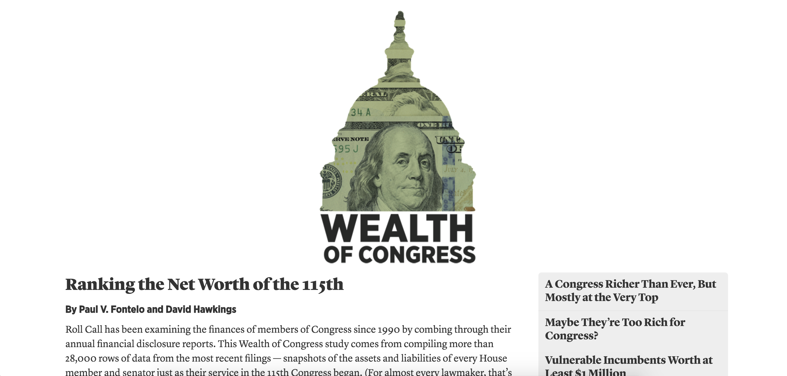
Financial disclosures

Slide 36
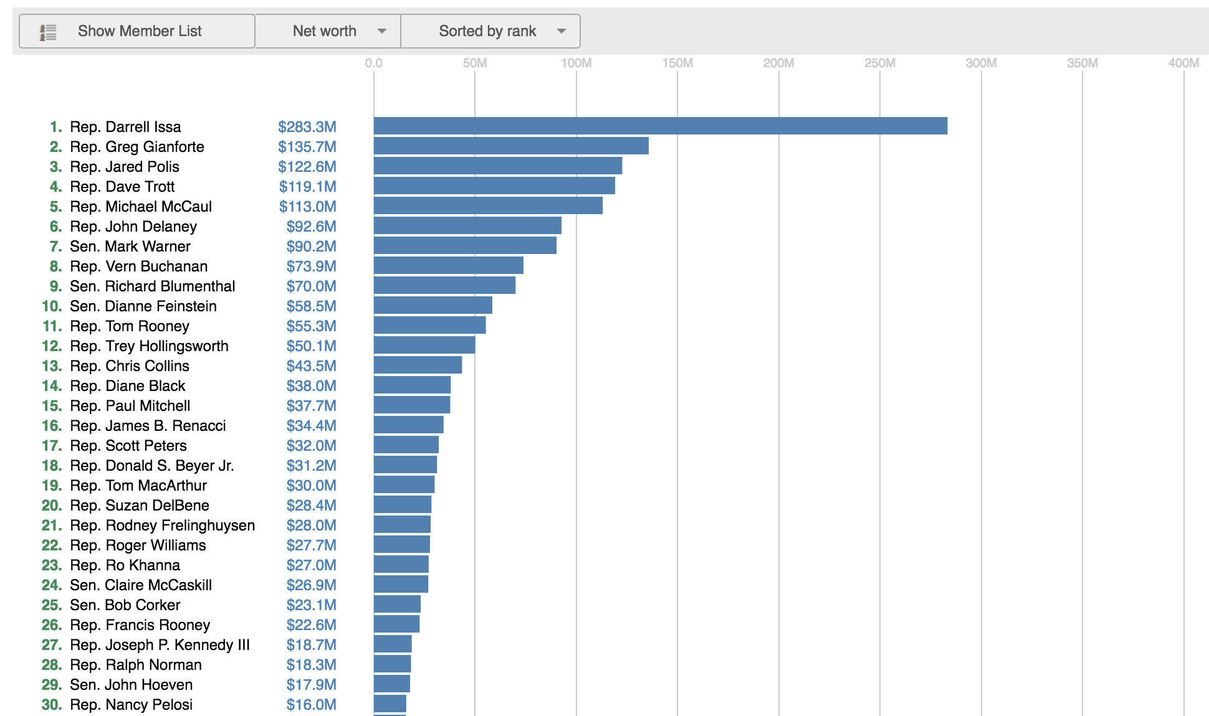
Financial disclosures

Slide 37
Financial disclosures
House: http://clerk.house.gov/public_disc/financial-search.aspx
Senate: https://efdsearch.senate.gov/search/
Notes:
Look up Collins in House
Look up Danny Davis in IL

Slide 38

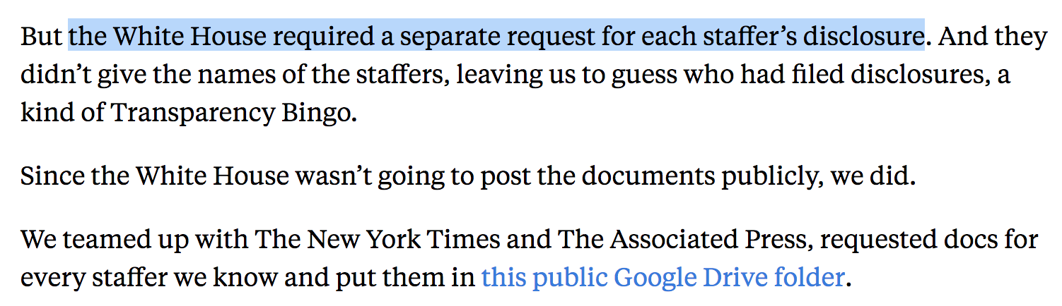
Financial disclosures

Slide 39
Other Resources
Opensecrets.org
Sunlght Foundation https://sunlightfoundation.com/projects/
Propublica FEC Itemizer https://projects.propublica.org/itemizer/

